Slide 1


Marathwada Mitra Mandal’s College Of Engineering Pune Accredited with ‘A++' Grade by NAAC
Project Title
“Maximum Power Point Tracker with Controlled Opto-isolated
Solid-state outputs and function-driven status display”
Project Guide
Prof. Jitendra Bakliwal
BY
Advait Thale (T190453143)
Mansi Veer (T190453148)

Slide 2



Outlines
Introduction
Literature Survey
Tools Requirement
Specifications
Block Diagram and Working
Flowchart and Algorithm
Conclusion
Future Scope
Schedule
References

Slide 3
Introduction
Maximum Power Point Tracking (MPPT) is a crucial technique employed in photovoltaic (PV) systems to optimize the power output of solar panels by dynamically adjusting the operating point to the MPPT under varying environmental conditions. The performance of MPPT algorithms can be influenced by various factors, including system design, algorithm selection, sensor accuracy, tracking speed, and adaptability to different environmental conditions. MPPT algorithms can be implemented in hardware using microcontrollers, digital signal processors (DSPs), or specialized MPPT controller ICs.
Implementation of MPPT with QR topology requires careful consideration of circuit layout, component selection, and control strategy to achieve optimal performance.
An Opto-isolator also known as an optocoupler is an electronic device that provides electrical isolation between two circuits using light. It consists of an LED (light-emitting diode) on one side and a photodetector (typically a phototransistor) on the other side.
A solid-state relay is an electronic switch that uses semiconductor devices (such as MOSFETs or thyristors) to control the flow of current without any mechanical parts. The SSR should have sufficient current and voltage ratings to handle the desired load.

Slide 4
Literature survey
The literature survey presents an overview of the Maximum Power Point Tracker, Controllable Opto-isolated Solid state outputs, and function scrolling on LCD. The journals were analyzed and content was presented with ideas that were focused on improvising the existing system and trying to implement a cost-efficient alternative to existing MPPTs. IOT-based microcontrollers have been applied in domestic, medical, industrial, and security fields and in remote monitoring.
We have used the ESP32 microcontroller for controlling and monitoring all the ongoing operations and also used C and C++ programming languages as the whole ESP program environment is built on them and they are the most efficient programming languages for writing libraries and efficiently compiling the program.
A 16*2 character LCD placed atop the enclosure is used to display the voltage, current, and temperature parameters of the battery and produced voltage from the PV panels settings menu on the display voltage control.

Slide 5
Requirement Tools
Software:-
Proteus
VS Code
Platform IO Plugins
Arduino IDE
Hardware:-
ESP32
IR Receiver
LM7805
16*2 LCD
6V lead acid battery
IRFZ44
Photovoltaic Panel
2N2222A

Slide 6
Specifications
ESP32:
Single or dual-core 32-bit LX6 Microprocessor with clock frequency up to 240 MHz.
34 Programmable GPIOs.
Supports both Classic Bluetooth v4.2 and BLE specifications.
Motor PWM and up to 16 channels of LED.
Secure boot and flash encryption.
IR Receiver:
Receives data at 38kHz of carrier frequency.
The data rate of TSOP1738 is up to 2400bps.
TSOP is used to receive data that supports various transmitter code.

Slide 7
Specifications
4V Acid Battery:
It is a Valve-regulated lead-acid battery.
Nominal voltage: 4V.
Nominal capacity: 1Ah.
Charging Voltage: 4.8V to 5.2V.
Long-lasting battery and minimal maintenance required.
LM7805:
3-terminal Regulators.
Output Current up to 1.5A.
Internal Thermal-Overload Protection.
High Power-Dissipation Capability.
Internal Short-Circuit Current Limiting.

Slide 8
Specifications
IRFZ44:
The minimum gate threshold voltage is 2V.
Maximum gate threshold voltage is 4V.
Pulsed Drain Current (ID peak) is 160A.
Continuous Drain Current (ID)IS 49A at 25°C
Small signal N-Channel MOSFET.

Slide 9
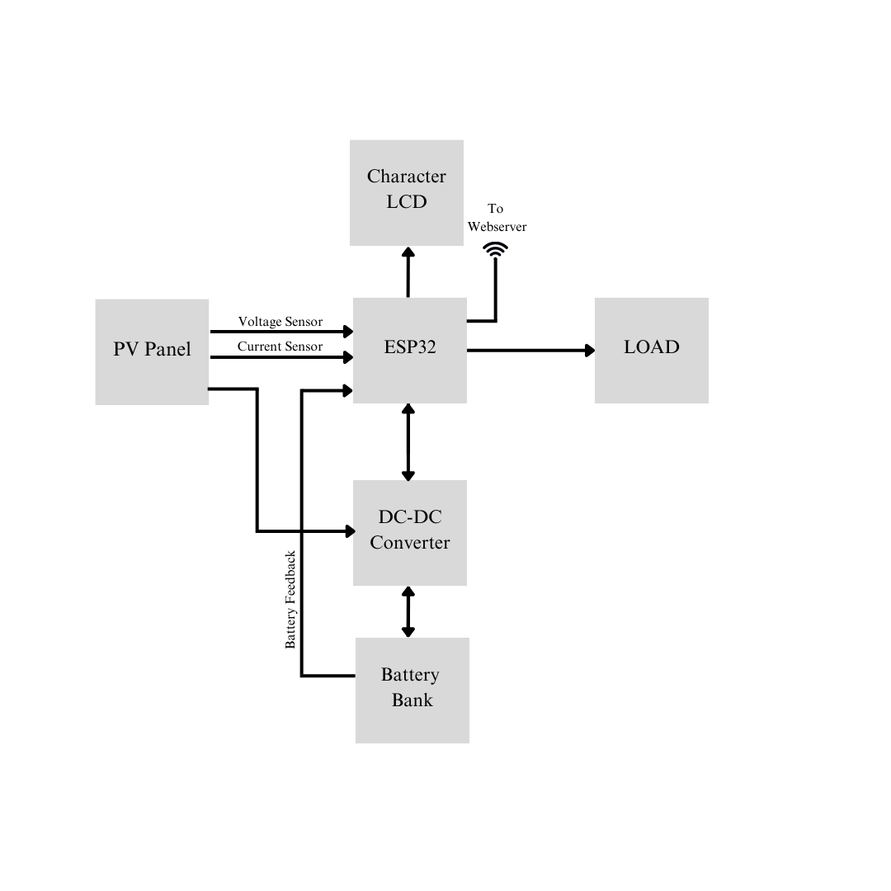
Block Diagram and Working

Slide 10
Working
The ESP32 is used to control all the important tasks for charging/ using battery bank, to monitor the voltage and current of battery and power generated by PV Panels. The obtained data can be viewed on the character LCD atop of the MPPT enclosure as well as on the webserver in real time. With the help of connected current sensor and ADC, it constantly checks how much voltage is being generated by photovoltaic panels, current flowing through the batteries or battery bank, temperature of battery bank along with cut-off protection in case of battery overheating. The two MOSFET controlled outputs can be used for connecting DC load of 12V Max. The outputs are normally controlled by microcontroller at normal MPPT operations but can be manually controlled by IR remote. If the battery is overheated or is fully charged in those intervals various alerts occur. A header port for KY040 rotary encoder is kept for controlling the output load voltage and battery charge parameters. Also, a header for inverter is routed on the PCB for Inverter daughterboard for further expansion.

Slide 11
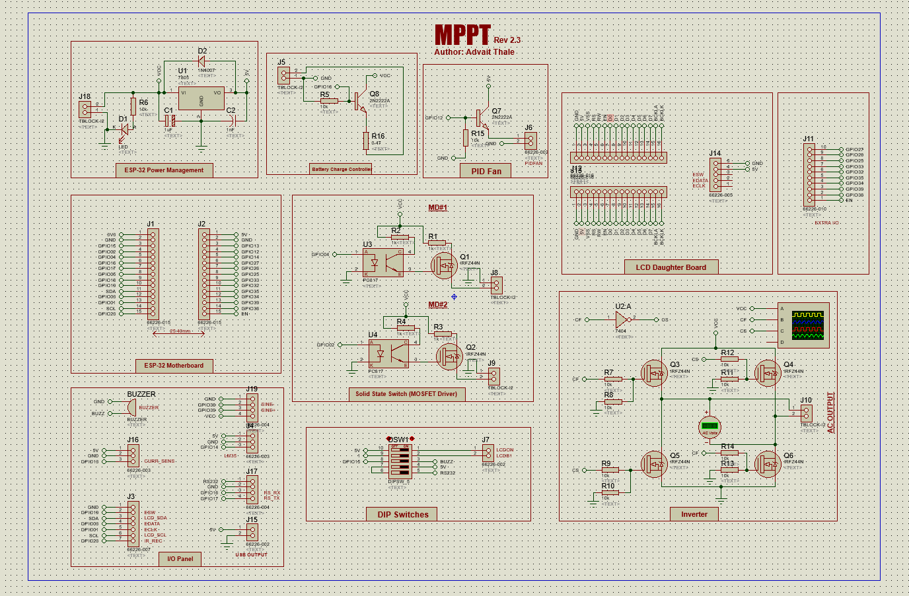
Circuit Diagram

Slide 12
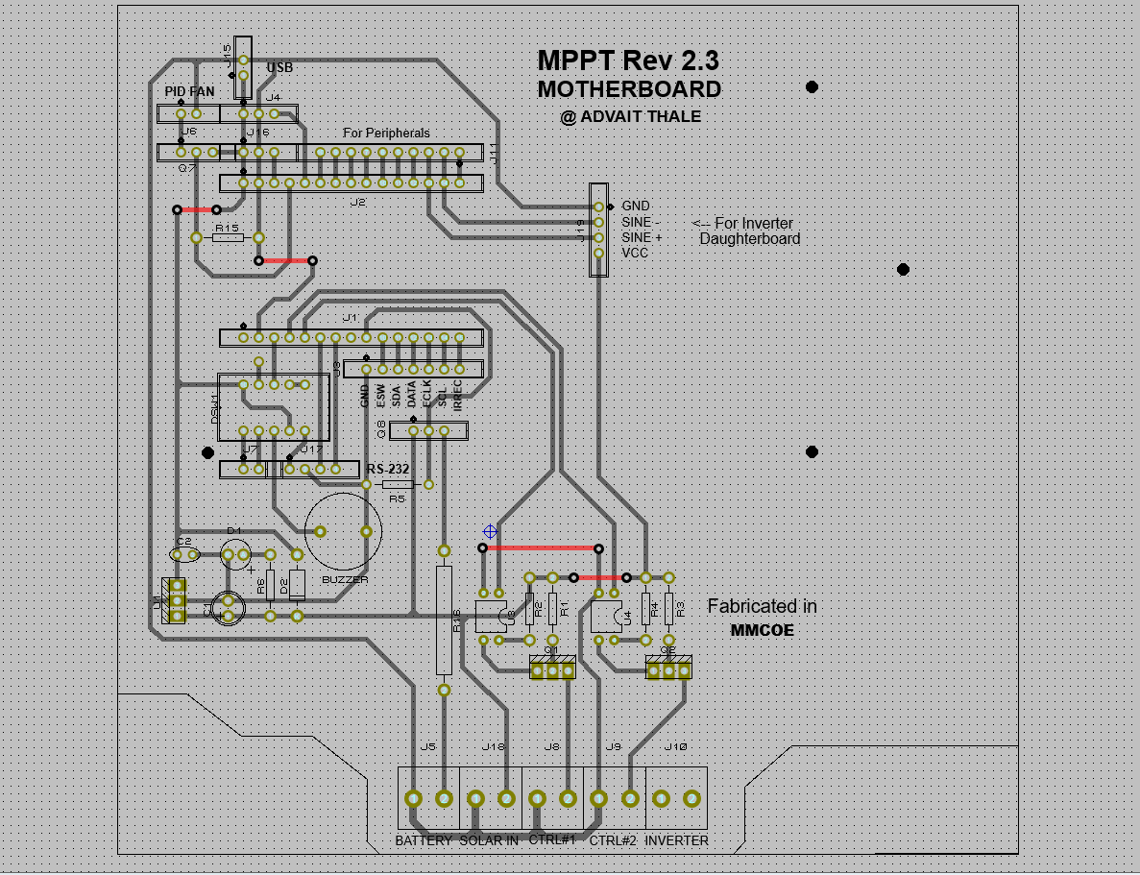
PCB Artwork of Main Board

Slide 13
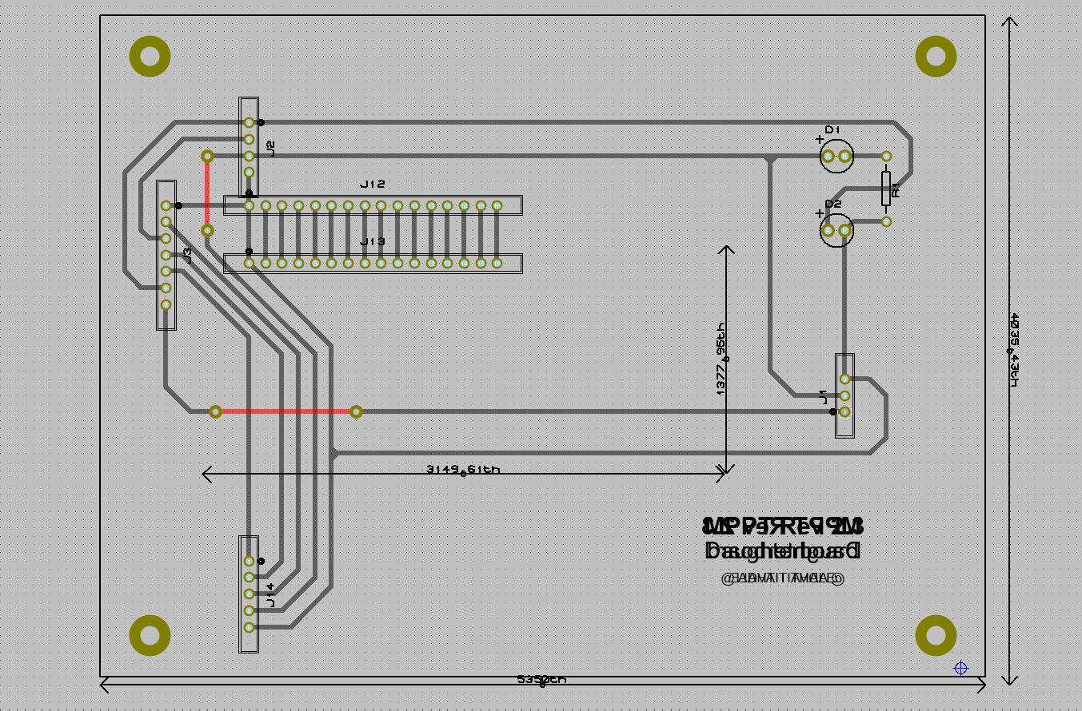
PCB Layout of LCD Daughterboard

Slide 14
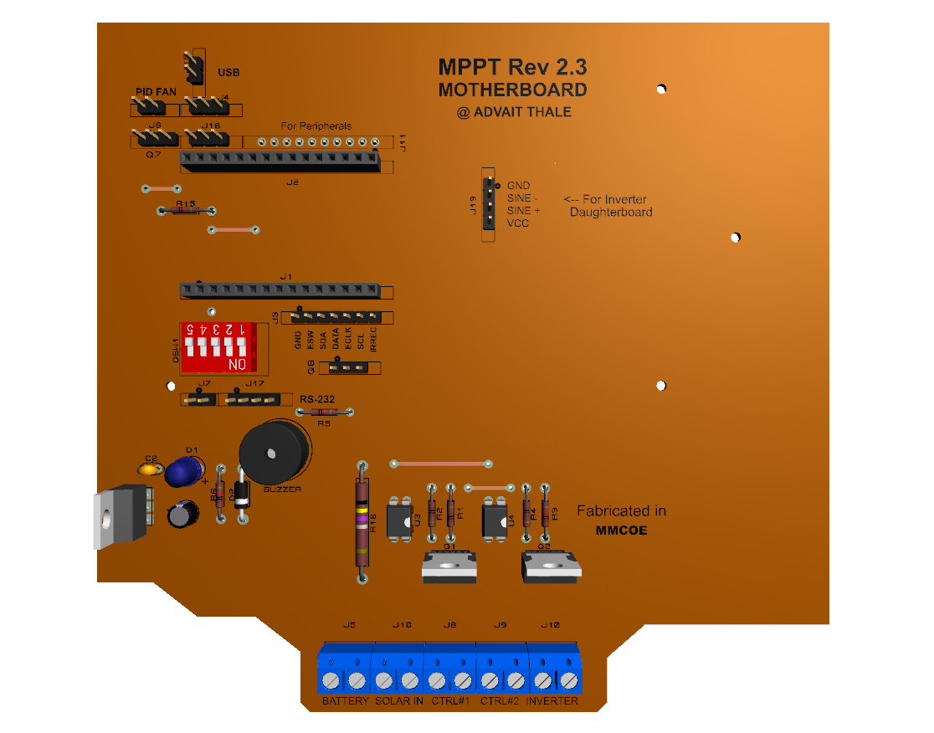
3D Render of Main Board

Slide 15
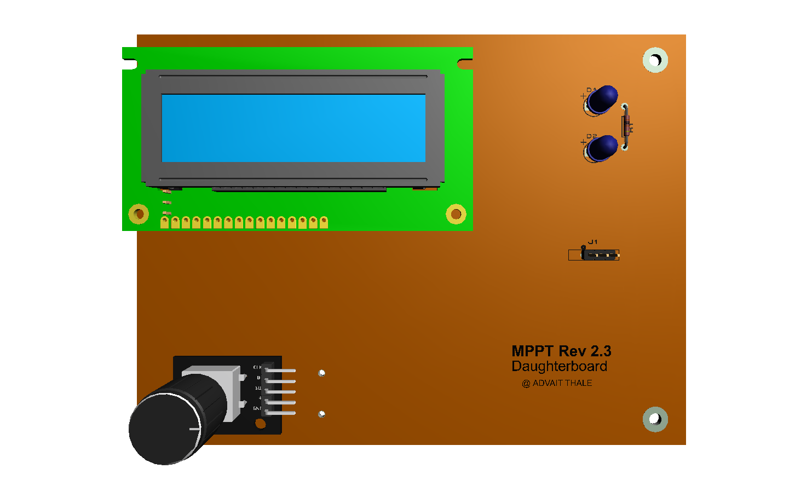
3D Render of LCD Daughterboard

Slide 16
Conclusion
Thus, we have demonstrated a working prototype of Output controllable MPPT with Webserver. It shows the Battery charging parameters such as voltage, current across and input power parameters on the character LCD as well as can be viewed on the Webserver by connecting to ESP32 via Wi-Fi and browsing 192.168.1.1 address on the internet browser such as Chrome, Edge, etc. We tried to improve productivity and efficiency of already available device in the market and concluded that it is doable. The data obtained provides high accuracy, good repeatability and increases productivity.

Slide 17
Future Scope
Future research can focus on developing advanced control algorithms for MPPT with QR topology. This includes the integration of AI Techniques such as machine learning, neural networks, and can be explored in the context of energy storage systems including incorporating battery storage, supercapacitors, or hybrid energy storage technologies to improve the overall efficiency, stability and reliability of renewable energy systems.
MPPT with QR topology can be integrated into hybrid renewable energy systems that combine multiple sources such as solar, wind and storage.

Slide 18
Schedule
Week 1 (27-1-23): Group formation and problem statement search.
Week 2 (3-2-23): Project Topic finalization.
Week 3 (10-2-23): Problem-solving and circuit designing.
Week 4(17-2-23): Component availability checks according to a circuit.
Week 5 (24-2-23): Finalizing circuit diagram with available components.
Week 6 (3-3-23): PCB Designing.
Week 7 (10-3-23): Purchased Enclosure and adjusted PCB size.
Week 8 (17-3-23): Finalizing PCB Artwork.

Slide 19
Schedule
Week 9 (2-43-23): Manufacturing PCB.
Week 10 (31-3-23): Assembling components on PCB and Testing.
Week 11 (8-4-23): Optimizing code and LCD Daughterboard design.
Week 12 (13-4-23): Code correction and testing.
Week 13 (21-4-23): Final PCB fitting in an enclosure and project review to guide.
Week 14 (3284-23): Project Presentation.

Slide 20
References
Paul Horowitz, Winfield Hill, “Power Sources: Battery Types”, in The Art of Electronics, Second Edition, Pg. 920-931.
D. P. Kothari, I.J. Nagrath, “Solar Energy & its Utilisation”, in Modern Power System Analysis, Fourth Edition, Pg. 32-42.
Paul Horowitz, Winfield Hill, “Solar Cells”, in The Art of Electronics, Second Edition, Pg. 932- 933.

